Slide 1
Logistic Regression
Prof. Andy Field

Slide 2
Aims
When and Why do we Use Logistic Regression?
Binary
Multinomial
Theory Behind Logistic Regression
Assessing the Model
Assessing predictors
Things that can go Wrong
Interpreting Logistic Regression

Slide 3
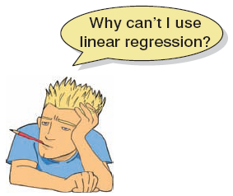
When And Why
To predict an outcome variable that is categorical from one or more categorical or continuous predictor variables.
Used because having a categorical outcome variable violates the assumption of linearity in normal regression.

Slide 4
With One Predictor
Outcome
We predict the probability of the outcome occurring
b₀ and b₀
Can be thought of in much the same way as multiple regression
Note the normal regression equation forms part of the logistic regression equation

Slide 5
With Several Predictor
Outcome
We still predict the probability of the outcome occurring
Differences
Note the multiple regression equation forms part of the logistic regression equation
This part of the equation expands to accommodate additional predictors

Slide 6
Assessing the Model: the log-likelihood statistic
The Log-likelihood statistic
Analogous to the residual sum of squares in multiple regression
It is an indicator of how much unexplained information there is after the model has been fitted.
Large values indicate poorly fitting statistical models.

Slide 7
Assessing the Model: the deviance statistic
The deviance is very closely related to the log-likelihood: it’s given by
Deviance = −2 × log-likelihood
It’s possible to calculate a log-likelihood or deviance for different models and to compare these models by looking at the difference between their deviances.

Slide 8
Assessing the model: R and R²
This R-statistic
is the partial correlation between the outcome variable and each of the predictor variables.
It can vary between −1 and 1.
The R-statistic is given by:
Or:

Slide 9
Assessing Predictors: The Wald Statistic
Similar to t-statistic in Regression.
Tests the null hypothesis that b = 0.
Is biased when b is large.
Better to look at Likelihood-ratio statistics.

Slide 10
The odds ratio: exp(B)
Indicates the change in odds resulting from a unit change in the predictor.
OR > 1: Predictor ↑, Probability of outcome occurring ↑.
OR < 1: Predictor ↑, Probability of outcome occurring ↓.

Slide 11
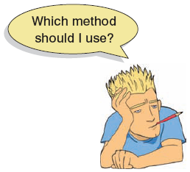
Methods of Regression
Forced Entry: All variables entered simultaneously.
Hierarchical: Variables entered in blocks.
Blocks should be based on past research, or theory being tested. Good Method.
Stepwise: Variables entered on the basis of statistical criteria (i.e. relative contribution to predicting outcome).
Should be used only for exploratory analysis.

Slide 12
Model building and Parsimony
When building a model we should strive for parsimony.
predictors should not be included unless they have explanatory benefit.
First fit the model that includes all potential predictors, and then systematically remove any that don’t seem to contribute to the model.

Slide 13
Things That Can go Wrong
Assumptions from Linear Regression:
Linearity
Independence of Errors
Multicollinearity
Unique Problems
Incomplete Information
Complete Separation
Overdispersion

Slide 14
Incomplete Information From the Predictors
Categorical Predictors:
Predicting cancer from smoking and eating tomatoes.
We don’t know what happens when nonsmokers eat tomatoes because we have no data in this cell of the design.
Continuous variables
Will your sample contain a to include an 80 year old, highly anxious, Buddhist left-handed lesbian?

Slide 15
Complete Separation
When the outcome variable can be perfectly predicted.
E.g. predicting whether someone is a burglar or your teenage son or your cat based on weight.
Weight is a perfect predictor of cat/burglar unless you have a very fat cat indeed!

Slide 16
Overdispersion
Overdispersion is where the variance is larger than expected from the model.
This can be caused by violating the assumption of independence.
This problem makes the standard errors too small!

Slide 17
An Example
Predictors of a treatment intervention.
Participants
113 adults with a medical problem
Outcome:
Cured (1) or not cured (0).
Predictors:
Intervention: intervention or no treatment.
Duration: the number of days before treatment that the patient had the problem.

Slide 18
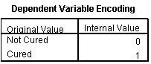
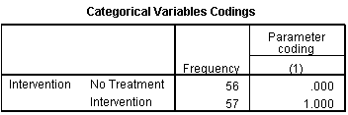
Output: Initial Model

Slide 19
Output: Initial analysis

Slide 20
Output: Block 0

Slide 21
Output: Model Summary

Slide 22
Output: Model Summary

Slide 23
Model Summary

Slide 24
Classification Plot

Slide 25

Summary
The overall fit of the final model is shown by −2LL and its associated chi-square statistic.
If the significance of the chi-square statistic is less than .05, then the model is a significant fit of the data.
Check the table labelled Variables in the equation to see the regression parameters for any predictors in the model.
Look at the Wald statistic and its significance.
Use the odds ratio, Exp(B), for interpretation.
OR > 1, then as the predictor increases, the odds of the outcome occurring increase.
OR < 1, then as the predictor increases, the odds of the outcome occurring decrease.
The confidence interval of Exp(B) should not cross 1.

Slide 26
Reporting the Analysis

Slide 27
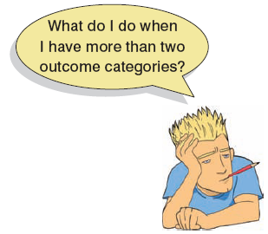
Multinomial logistic regression
Logistic regression to predict membership of more than two categories.
It (basically) works in the same way as binary logistic regression.
The analysis breaks the outcome variable down into a series of comparisons between two categories.
E.g., if you have three outcome categories (A, B and C), then the analysis will consist of two comparisons that you choose:
Compare everything against your first category (e.g. A vs. B and A vs. C),
Or your last category (e.g. A vs. C and B vs. C),
Or a custom category (e.g. B vs. A and B vs. C).
The important parts of the analysis and output are much the same as we have just seen for binary logistic regression

Slide 28
I may not be Fred Flintstone …
How successful are chat-up lines?
The chat-up lines used by 348 men and 672 women in a night-club were recorded.
Outcome:
Whether the chat-up line resulted in one of the following three events:
The person got no response or the recipient walked away,
The person obtained the recipient’s phone number,
The person left the night-club with the recipient.
Predictors:
The content of the chat-up lines were rated for:
Funniness (0 = not funny at all, 10 = the funniest thing that I have ever heard)
Sexuality (0 = no sexual content at all, 10 = very sexually direct)
Moral vales (0 = the chat-up line does not reflect good characteristics, 10 = the chat-up line is very indicative of good characteristics).
Gender of recipient

Slide 29
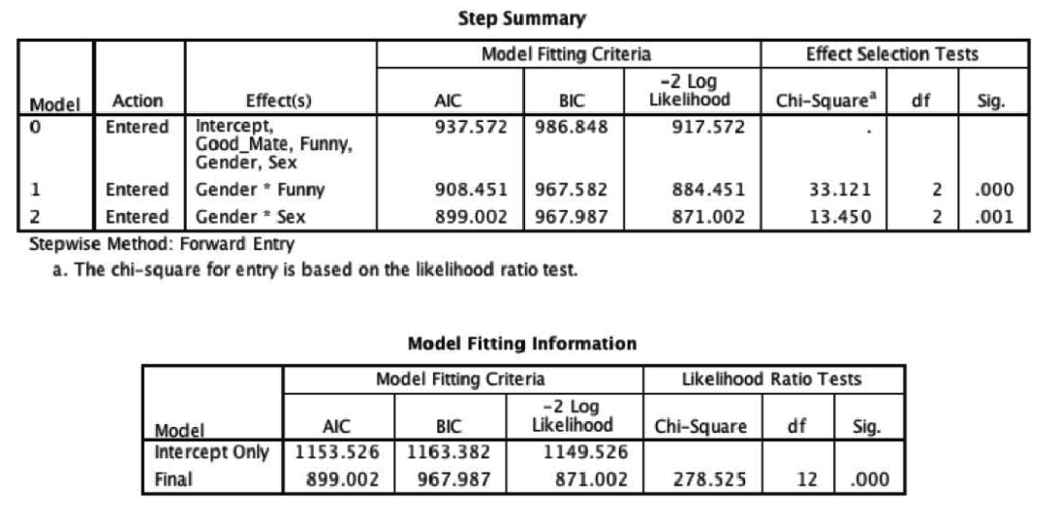
Output I

Slide 30
Output II

Slide 31
Output III

Slide 32
Interpretation I
Good_Mate: Whether the chat-up line showed signs of good moral fibre did not significantly predict whether you went home with the date or got a slap in the face, b = 0.13, Wald χ²(1) = 2.42, p = .120.
Funny: Whether the chat-up line was funny significantly predicted whether you went home with the date or no response, b = 0.32, Wald χ²(1) = 6.46, p = .011.
Gender: The gender of the person being chatted up significantly predicted whether they went home with the person or gave no response, b = −5.63, Wald χ²(1) = 17.93, p < .001.
Sex: The sexual content of the chat-up line significantly predicted whether you went home with the date or got a slap in the face, b = 0.42, Wald χ²(1) = 11.68, p = .001.

Slide 33
Interpretation II
Funny × Gender: The success of funny chat-up lines depended on whether they were delivered to a man or a woman because in interaction these variables predicted whether or not you went home with the date, b = 1.17, Wald χ²(1) = 34.63, p < .001.
Sex × Gender: The success of chat-up lines with sexual content depended on whether they were delivered to a man or a woman because in interaction these variables predicted whether or not you went home with the date, b = −0.48, Wald χ²(1) = 8.51, p = .004.

Slide 34
Reporting the Results

